Slide 1
Link-Based Lists
Lists without all the Duplication

Slide 2
The Down Side of Dynamic Arrays
Dynamic arrays require a lot of duplication
Every time you need more space, you copy ALL your data
Every time you need to add in the middle, you copy all the data from that point to the end
Every time you remove from the middle, you move all the data from that point to the end back a slot
All the data copying leads to a whole lot of wasted memory
Imagine hundreds of thousands of objects copied multiple times
Even with the garbage collector removing orphaned objects, the system slows down
The upper bound on the array is always going to be a problem
Solution: Don’t use something with an upper bound

Slide 3
Link-based Lists (AKA Linked Lists)
Arrays are a continuous section of memory
This can’t be expanded on demand, need to build a whole new continuous section to “grow” it
Instead of a continuous section, what if each element pointed to where the next was?
To add a new element, we store a “pointer” to it in the (previous) final element in the list
No limit to the number of elements that can be added!
Every time we add a new one, we update the old final element to point to it
To access data, we can follow the trail of pointers/links through the list of elements

Slide 4
Illustrating a Linked List
Element 0
“David”
Next Element
Element 1
“Alan”
Next Element
Element 2
“Ellen”
Next Element
Null
Every entry (“node”) in the list has a link to the next one
The last node in the list has a link to null (i.e. it’s the end)
When moving through the list, while the next element isn’t null, we’re not at the end

Slide 5
Adding to the End of a Linked List
Element 0
“David”
Next
Element 1
“Alan”
Next
Element 2
“Ellen”
Next
Element 3
“New Guy”
Next
Null
To add to a linked list, we need to:
Update the pointer in the node at the end of the list
Set the pointer in the new element to be null

Slide 6
Adding to the Middle of a Linked List
Element 0
“David”
Next
Element 1
“Alan”
Next
Element 2
“New Guy”
Next
Element 2 3
“Ellen”
Next
Null
To add to the middle of a linked list, we need to:
Set the pointer in the new element to be the one we’re taking the position of
Update the pointer in the node BEFORE where we’re adding our new element to point to us
The element that was in position 2 is now in position 3
The new element is now in position 2

Slide 7
Implementing a Link-Based List: Data Storage
Need a fixed starting point.
Find the start of the chain/list, then follow the links to find the rest of the data.
Need an overall Linked List class that:
Points to the first element.
Provides methods to access the list as a whole.

Slide 8
A Hidden Requirement: The Node class
A linked list is made up of a chain of nodes
Each node needs to store both data AND a reference to the next node
Therefore, we need to create a Node class
The Node class is only needed by the Linked List class
Code using the linked list should not create Nodes to give to the list, it should pass the list their data*
If the class is *only* needed by the Linked List class, we can use a special trick to keep it separate
Make it an inner class – create it within the Linked List class
Make it private – close it off to other classes
Notes:
*Think about how you use an ArrayList – do you have to create a wrapper around what you’re storing when you put it in?

Slide 9
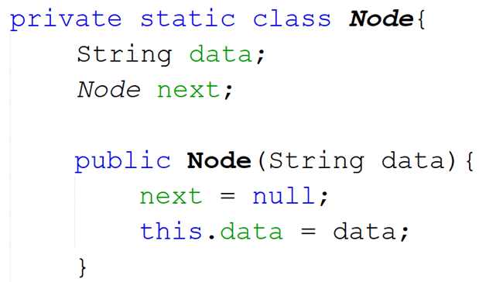
Implementing a Node Class
Two components to a Node:
Data being stored (Whatever type it may be).
Reference/pointer to next node in the list.
The Node class should be created within the Linked List class
Basic structure of a Node class:
The Node class is marked as private static
Should be private so other classes can’t access it
Should be static so the Linked List class can access within it directly
When a Node is created, the reference to the next node is blank

Slide 10
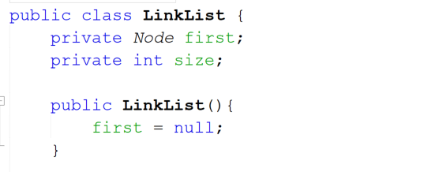
Implementing a Linked List as a Class
Two components to a Linked List:
Reference to first node.
Count of how many nodes are in the list.
Basic structure of a Linked List:
Remember, the Node contains:
a) The data to be stored
b) A reference to the next
node in the list
Every time a new piece of data is added, the size counter should be incremented
When the list is started, the first reference/node is blank

Slide 11
Implementing a Link-Based List: Providing List Functionality
Main list functionality:
Find the size
Get an element from a specific position
Find an element
Add an element
Remove an element

Slide 12
Getting the Size of a Link-Based List
Just like in a dynamic array, we are maintaining a count of how many elements are currently in the list.
When we add a new element, we increase the count.
When we remove an element, we decrease the count.
Returning the count of elements will give us the current size of the list.

Slide 13
Getting an Element From a Specific Position in a Link-Based List
Unlike arrays, we cannot go straight to a specific position in a link-based list.
We only know the location of the first element in the list.
To get to the Xth position, we need to move through the list X number of times:
Follow the “pointer” from the current element to the next one.
Keep doing this until we reach the right position.

Slide 14
Moving Through a Link-Based List: Theory
Pseudocode to move through a list:
Create a temp node pointing to the first node stored in the list (current)
While the temp node’s next reference does not point to null (i.e. while we’re not at the end)
Set the temp node to point to the next node (shift across by one)
By the time the loop ends, the temp node will be pointing to the final one

Slide 15
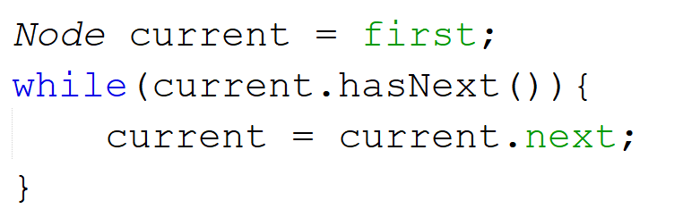
Implementing Moving Through a Linked List
This will move from the start through to the end
To move to a specific node, change the loop, e.g.:
Looping to a position: use a for loop to count to that position
Looping to a match: combine the hasNext() check and a check on the data within the node

Slide 16
Getting an Element From a Specific Position in a Link-Based List (2)
Pseudocode:
Check if the position is valid
Position should be >= 0
Position should be < the size of the list
If it’s not, throw an IndexOutOfBoundsException
If the position is valid:
Loop until your counter < position to be retrieved
Return the data at this position

Slide 17
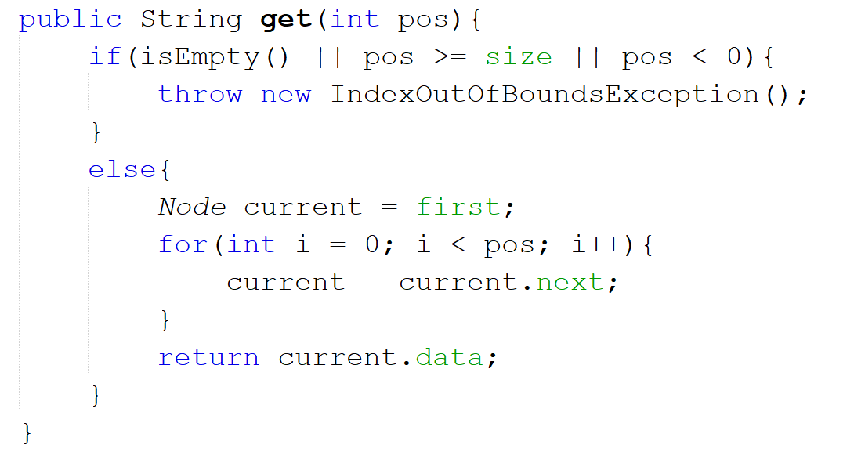
Implementing Getting From a Specific Position
Check if the position is valid
Move through the list to get to the specified position
Return the data at that position

Slide 18
Finding an Element in the Link-Based List
Just like with dynamic arrays, link-based lists are unsorted by default.
Linear search is needed again!
Same basic idea as for dynamic arrays (different in practice):
For each element from start of array as far as the end of the data
Check if current element matches what we need
If yes, return this position
If we reach the end of the structure without finding a match
Return -1

Slide 19
Pseudocode for Finding An Element in a Link-Based List
Store the first element in your current Node
Initialise a counter to 0.
While the current element is not null:
If the current element’s data equals what we’re looking for
Return counter’s value
If not, then move to the next element and increase the counter by 1
If we get to the end of the loop without finding a match, return -1

Slide 20
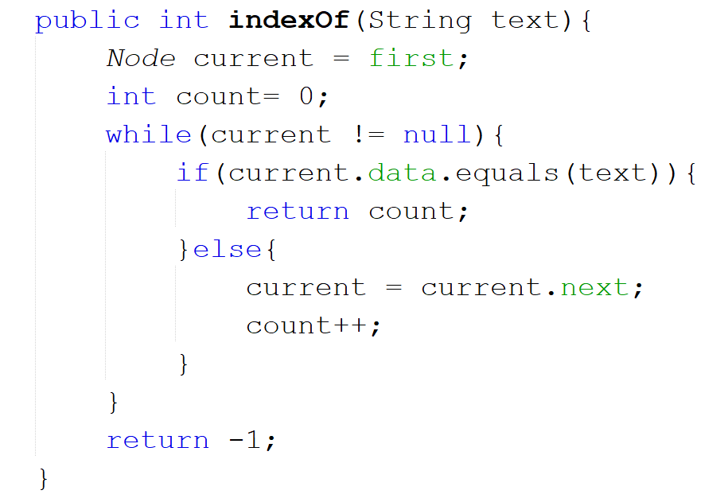
Implementing Finding an Element in an Link-Based List
Set up our information, ready to search
Move through the list and check each element to see if it matches
If we get to the end of the loop, then there was no match found in the list

Slide 21
Adding to a Link-Based List
Three approaches to adding:
Adding to the start (easy and fast!)
Adding to the end (easy, but SLOW)
Adding in the middle (Slightly more complex, slightly faster)

Slide 22
Adding to a Link-Based List: Adding to the Start of a List
Pseudocode:
Check if the list is empty.
If it is, set the first node to point to this one
If it’s not:
Set the next field in the new node to point to the current first node in the list
Set the first field to point to the new node
Update the size of the list

Slide 23
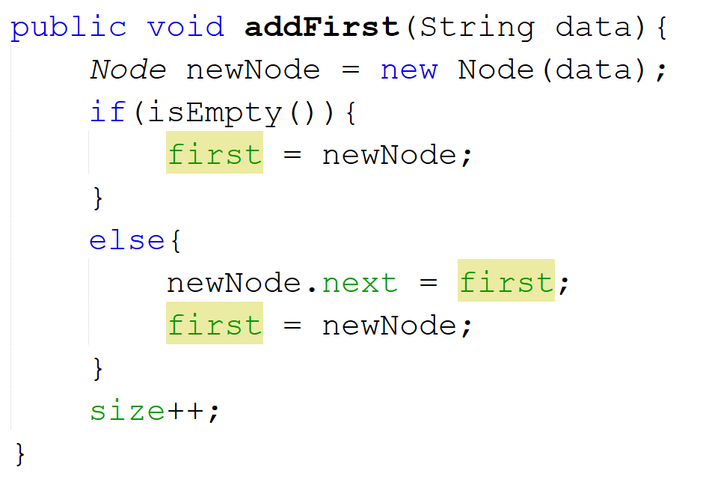
Adding to a Link-Based List: Implementing Adding to the Start of a List
Check if the list is empty
Set the new node’s next field to the node currently at the start of the list (first)
Set first to point to the new node
Increase the size of the list by one

Slide 24
Adding to a Link-Based List: Adding to the End of a List
Pseudocode:
Check if the list is empty.
If it is, set the first node to point to this one
If it’s not, move to the end of the list (see previous slide)
Set the next field within the node at the end of the list to point to our new node
Update the size of the list

Slide 25
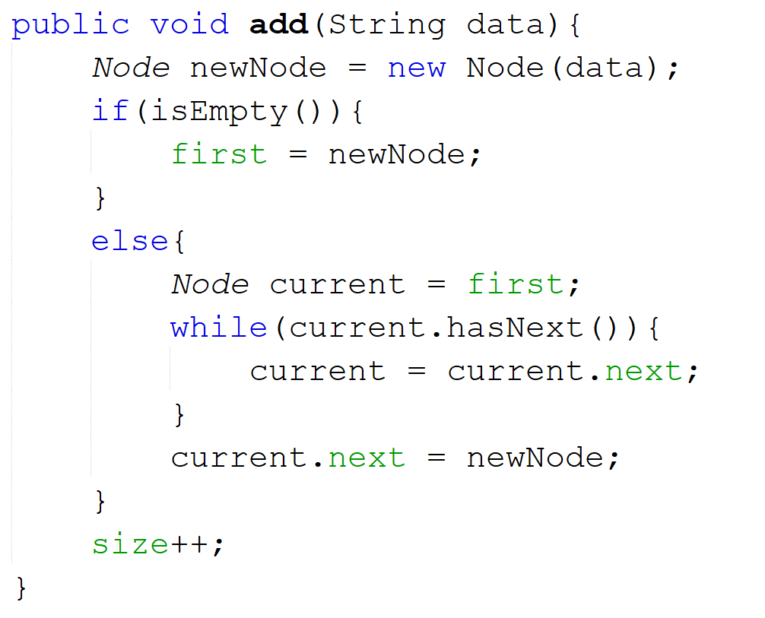
Adding to a Link-Based List: Implementing Adding to the End
Check if the list is empty.
If so, set the list’s first node to be this one.
Move through the list to get to the end
Set the reference within the list’s final node to point to this new one
Increase the size of the list by one

Slide 26
Adding to a Link-Based List: Adding to a Specific Position in a List
Pseudocode:
Check if the position is valid
Position should be >= 0
Position should be <= the size of the list
If it’s not, throw an IndexOutOfBoundsException
If the position is valid:
If the position == 0
Set first to be the new node
Otherwise:
Loop through the list up to the supplied position – 1 (we need the node BEFORE our position, we want to insert our node between this one and it’s next)
Point the new node’s next field to the node stored in the next field of the current node
newNode.next = current.next;
Point the current node’s next field to the new node
current.next = newNode;
Update the size of the list

Slide 27
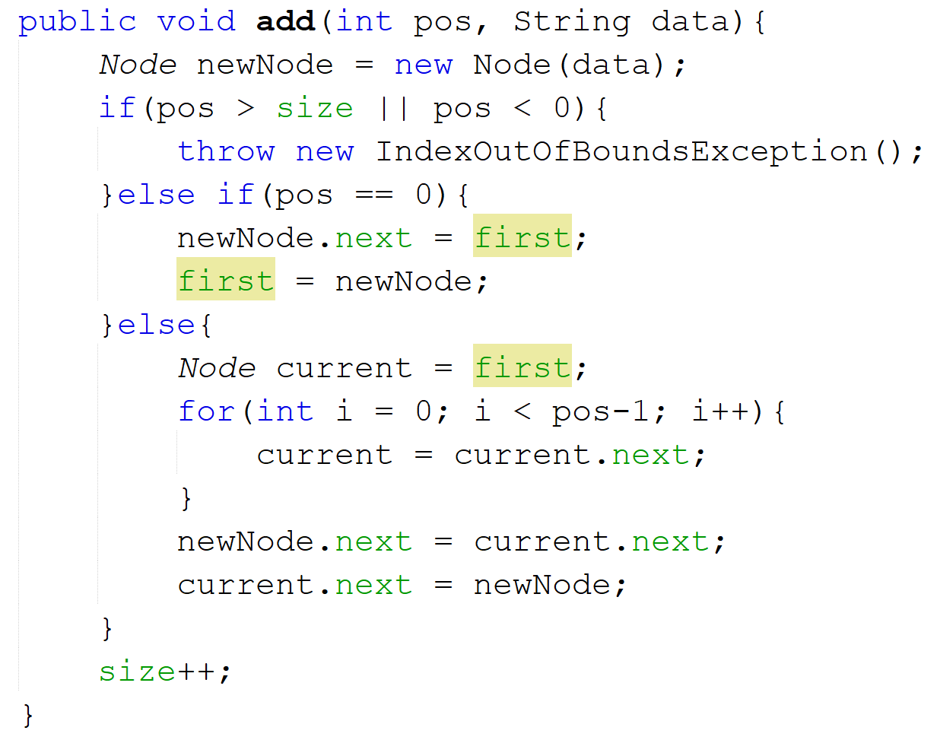
Adding to a Link-Based List: Implementing Adding to a Specific Position
Check if the position is valid
Check if they want to add the data to the start of the list
Loop through the list to the position BEFORE the one we want to add to
Insert the new node BETWEEN this node and the node currently in the selected position
Increase the size of the list by one

Slide 28
Removing From a Link-Based List
Two approaches to removing:
Removing from a position
Removing a specific value
Both actions have the same basic idea
Loop to find where to remove (tracking the “previous” element)
“Snip” the element being removed out of the list
Point the next node from the previous element to the next node of the one being removed.

Slide 29
Removing From a Link-Based List: Removing From a Specific Position in a List
Confirm that the supplied position is within the bounds of the list
If it’s not, throw an exception
If they want to remove the first element in the list:
Store the first element’s data in a temp variable
Set first = first.next
If they want to remove any other element:
Create a current Node to point to where we are in the list
Create a previous variable to track the Node before current
Loop to the position being removed. On each iteration:
Update previous to point to current
Update current to point to current.next
Save current.data in a temp variable
Set previous.next = current.next (snip the current Node out of the chain/list)
Decrease size of list by 1
Return the temp variable containing the data removed from the list.

Slide 30
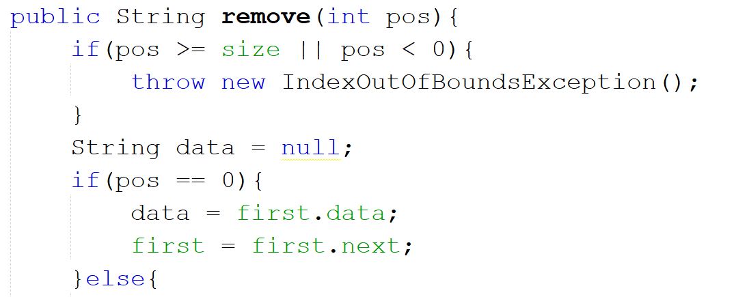
Removing From a Link-Based List: Implementing Removing From a Specific Position (1)
Check if the position is valid
Handle if they want to delete the first element in the list
Still to come: Handling deleting from everywhere else…

Slide 31
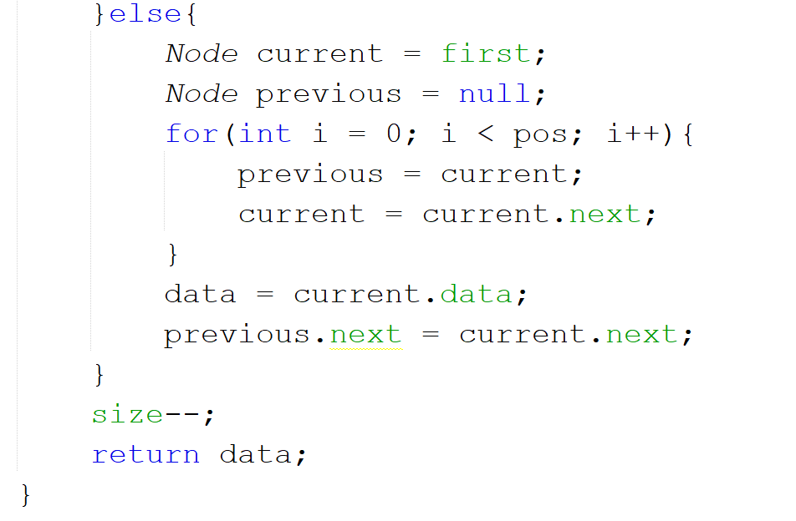
Removing From a Link-Based List: Implementing Removing From a Specific Position (2)
We need to track where we currently are in the list (current) AND the node right before us (previous. This starts as null because there’s nothing before the start element)
Loop through the list until we get to the right position.
Get a copy of the data being deleted
Update our element count and return our data
“Snip” the node at the specified position out of the chain/list.

Slide 32
Removing From a Link-Based List: Removing A Specific Element From a List
Create a current Node to point to where we are in the list
Create a previous variable to track the Node before current
Loop through the list. On each iteration:
Check if the current element matches what we’re looking for. If it does:
Set previous.next = current.next (snip the current Node out of the chain/list)
Decrease the size of the list by 1
Return true;
If it doesn’t match, move to the next element in the list:
Update previous to point to current
Update current to point to current.next
If we reach the end of the list without finding a match, return false

Slide 33
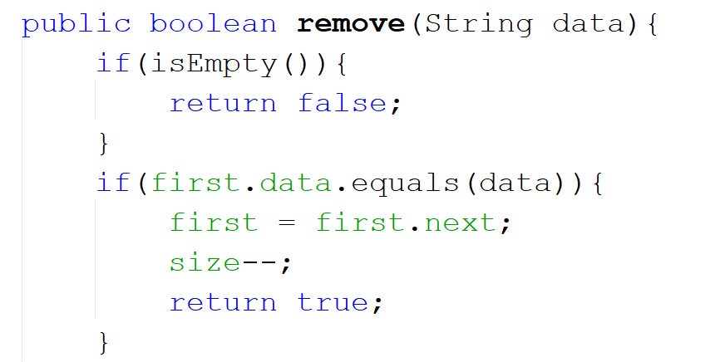
Removing From a Link-Based List: Implementing Removing A Specific Element (1)
Check if there’s even anything to remove
Check if the first element matches
If it does, snip that element out of the list, decrease the count and return that the data was removed

Slide 34
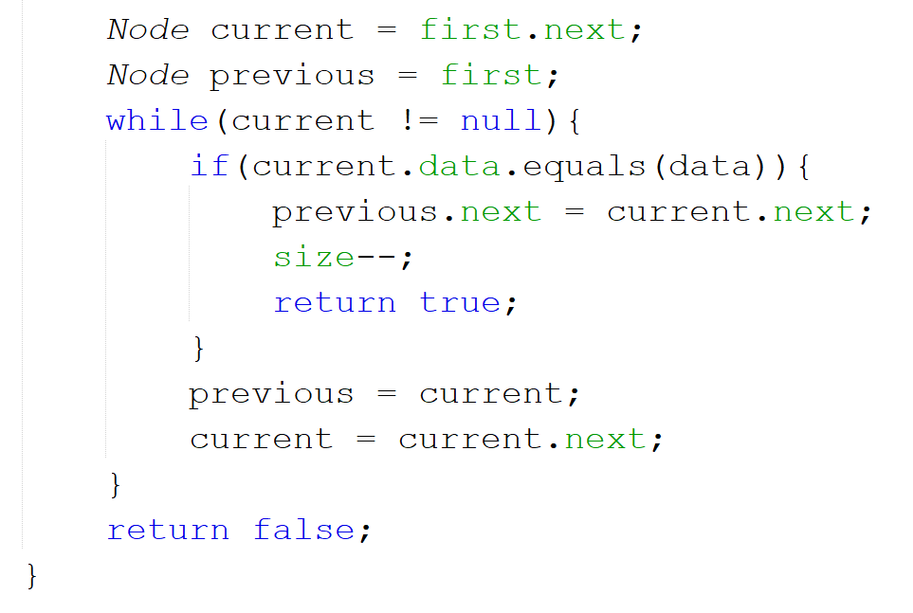
Removing From a Link-Based List: Implementing Removing A Specific Element (2)
Continuing from previous slide’s code
Set up variables to track where we are and what came before us
Check if the current element matches
If it does, snip that element out of the list, decrease the count and return that the data was removed
If it doesn’t, move on in the list
If we get to the end of the loop, we couldn’t find a match to remove.

Slide 35
Improving this Linked List
Adding to the end of this linked list is costly
Have to loop through to find the node at the end before you can link the new one on
We can optimise this by tracking the tail/end of the list
If we already know where the last node is, we don’t need to loop
Do this by adding a second node to the Linked List
Instead of just storing first, store first AND last

Slide 36
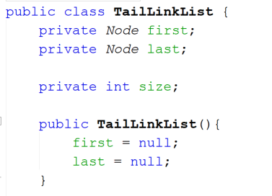
Implementing the Tail Improvement
Now there are two links within the list
One points to the start
One points to the end
Whenever you add to/remove from the start, update first
Whenever you add to/remove from the end, update last
When you add to an empty list, UPDATE BOTH
Notes:
When there is only a single entry in a list, it is both its first and its last element

Slide 37
Expanding Linked Lists
This is what’s known as a singly-linked list
There is only a single connection from one node to the next
Each node only points to one other node
Two other variants:
Circular linked list
Doubly-linked list

Slide 38
Circular Linked Lists
Very similar to singly-linked lists* but with one main change:
Final node in the list points to the first node in the list
i.e. finalNode.next = first
Very suited for queues, particularly when we are going to repeatedly loop through the queue to carry out a task
E.g. scheduling time on a processor – each thread gets a turn and when we reach the end of the queue, go back to the start
Question: How do you know when you reach the end of the list?
Notes:
*Can also be encoded as a doubly-linked list
A single link Node can only be used if you want to keep it as a singly-linked list. If you want to use a doubly-linked list approach to a Circular Linked List, you have to use the double link Node.

Slide 39
Doubly-Linked Lists
Every node contains TWO links
One to the node after it (as normal) : next
One to the node before it : prev
Amending the Node class:
What are the benefits of using this approach?
What are the disadvantages of this approach?

Slide 40
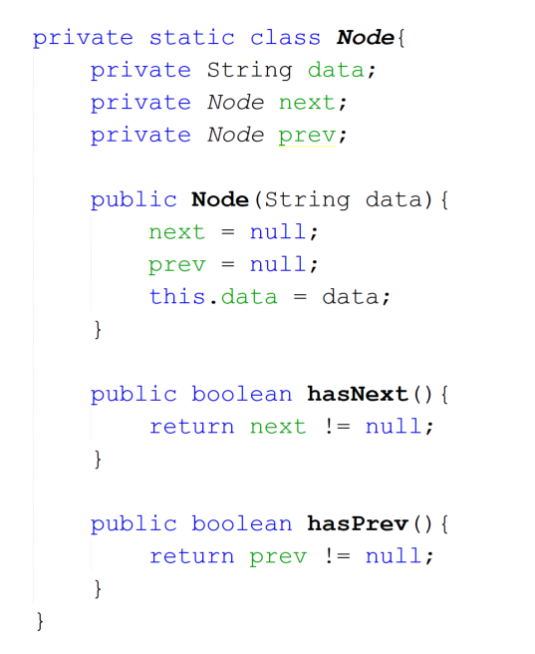
Amending the Node to Support DLLs
This version of Node supports doubly-linked lists (DLLs)
However, the linked list class itself must also change:
When a node is added or removed, there are up to FOUR links to maintain
Previously we only needed to update TWO at most

